Slide 1
CEngBall Project Contorium
Alper Demir, Doğa Uzuncukoğlu, Emre Can Küçükoğlu, Necati Çevik

Slide 2
What is CEngBall?
Programming game
A football like game
Artificial intelligence developing game

Slide 3
What is our aim?
Providing a platform to test A.I. skills in a fun way
Leaving a tradition to our department

Slide 4
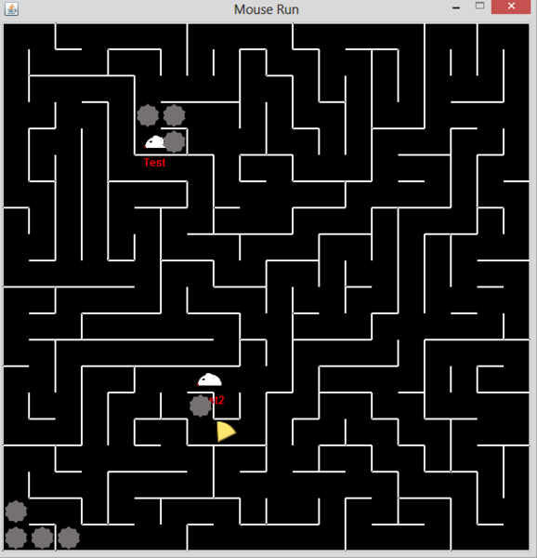
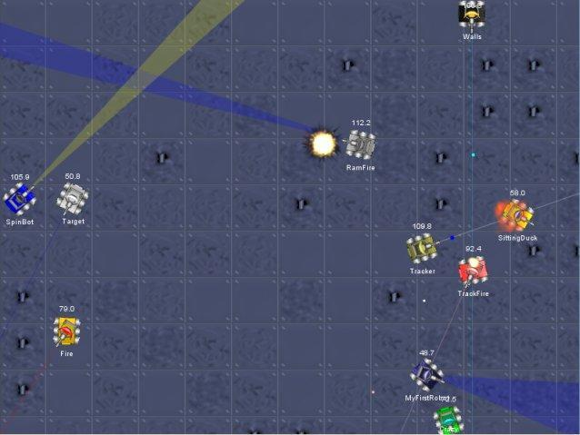
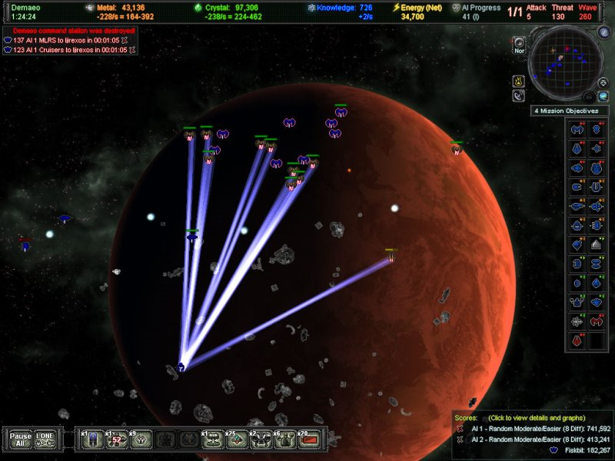
Similar Projects
Mouse Run
RoboCode
AI Wars

Slide 5
Design Overview
Basic Football Game
A.I. API
3 main components:
Simulator
Visualizer
A.I Agents

Slide 6
Simulator
Communicating with A.I agents
Providing information about past movements
Checking and applying movements
Simulating in a turn-based manner
Logging every action

Slide 7
Visualizer
Getting the movements
Playing the match

Slide 8
A.I. Agents
Making movements
Acting in an environment:
Fully observable
Stochastic
Dynamic
Multi-agent
Discrete
Sequential

Slide 9
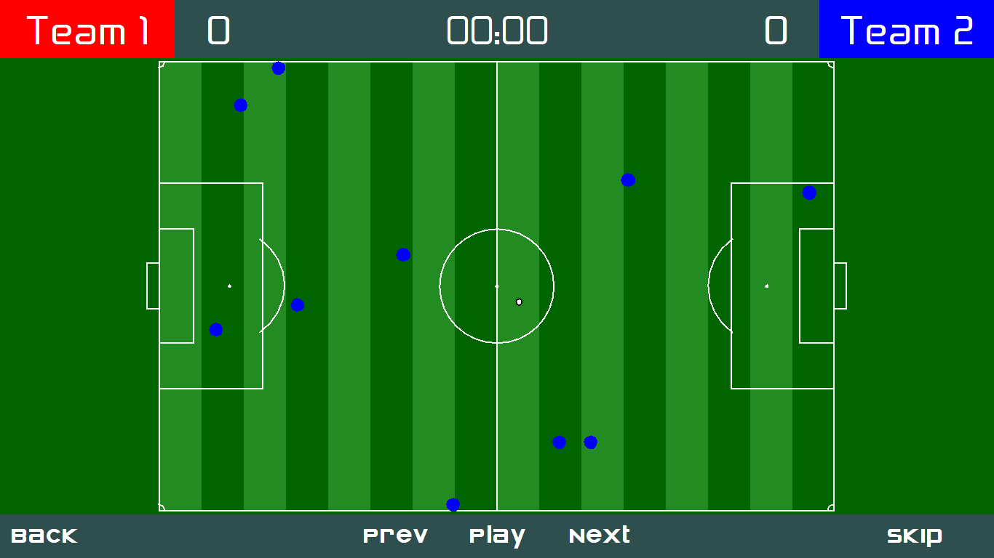
What we have done so far?
Save file
Visualizer

Slide 10
What are we going to do?
Simulator
Built-in agents

